Slide 1
Children’s brand relationships and brand preference: How preschool aged children influence the consumption of their parents. Tina Tímea Kásler Corvinus University of Budapest
6th International CONSUMER BRAND RELATIONSHIP Conference

Slide 2
Agenda
Introduction
Literature Review
Contribution of study
Research questions
Method
Results
Conclusion and Limitations

Slide 3
Introduction
From birth onwards, children consume an extensive amount of products, ranging from various foods, to clothing and toys, simultaneously influencing the purchasing behavior of their parents.
Children’s brand preferences are being taken into account in approximately one fifth of all purchase decisions (Page et. al, 2018), with an estimated $300 billion in yearly sales by influencing their parents as well as consuming directly (Strasburger, 2001).
Simultaneously, the purchase behavior of families has shifted over time.
Increase of women working,
Families become smaller,
Time spent shopping differs,
Reverse socialization.
Therefore, it is important to study the relationships developed between children and brands in the family setting.

Slide 4
Literature Review
Brand relationships and children
Fournier (1998)
Ji, 2002; Chaplin and John, 2005; Nairn et. al, 2008 (meta analysis by Fetscherin and Heinrich, 2015)
Lopez et. al (2018)
Parent consumption impacted by children
In store observations (Thomas and Garland, 1993; O’Dougherty et. Al, 2006; Buijzen and Valkenburg, 2008; Gram, 2015; Page et. al, 2018)
Suggest child influences based on personality traits of parents (Berey and Pollay, 1968; Hsieh et. al, 2006).
Role of first time life events (Koschate-Fischer et. al, 2018)
Brand preferences of children
Numerous papers have dealt with the brand preferences of school children (Chan, 2006; Halford et. al, 2007; Boyland and Halford, 2013)
Early brand reliance is encouraged by parental examples (Hite and Hite, 1995)
Children seem to have a greater influence on mothers’ brand preferences than mothers on children (Kim et. al, 2016)

Slide 5
Contribution of study
Children’s attempts to influence purchases may decrease somewhat with age depending on the type of product, but a mother’s yielding to request increases with age (Ward and Wackman, 1972).
The literature review shows that despite the growing importance of brands in children’s daily lives, the child–brand relationship of preschool age children remains understudied.
Brand preferences in children and young adults have been measured, however, the differences in small children have been neglected. However, these preferences can influence the entire family’s consumption pattern.
Furthermore the methodology of the current study differs from studies in the past offering new insights into the subject.
The studies outcomes could possibly present a unique solutions for marketers to build long-term positive brand relationships.

Slide 6
Research Questions
The purpose of this study is to understand and explain the process by which child consumers form relationships with brands, by exploring what child-brand relationships and preferences exist at pre-school level. Furthermore, the study aims to find out how these brand relationships impact the family’s purchase behavior.
Are brand relationships and brand preferences present in pre-school aged children?
How do pre-school children influence the family purchase behavior?

Slide 7
Method
In-depth interviews
In-depth interviews were conducted with 15 parents of 3-6 year old children in various regions of Hungary.
Each interview’s time span varied between an hour and an hour and a half. The interview took place either in the home of the participants or in a neutral environment.
In terms of sampling strategies, maximum-variety sampling was applied in order to adequately capture the heterogeneity in the population.
Interviews were audio-recorded with the respondent’s permission. All the transcripts were entered into an NVivo database to facilitate coding and data management. The transcripts were coded using methods of constant comparison, where data were reviewed and re-reviewed as new categories emerged.

Slide 8
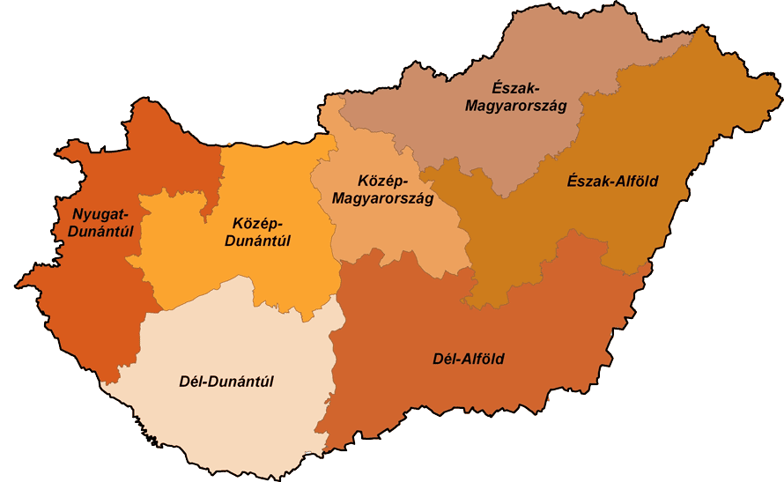
Sample22
2
3
2
4
2
2
2
3
2
6
1
3
3
2
1

Slide 9
Interview topics
Parents personal information
Children's personal information
Media equipments in the household
Eating habits of the children
Purchasing behavior of the families
Brand preferences of the family
Eating routines of the family

Slide 10
Results: Brand relationships and brand preference
Children only formed relationships with less than half of the brands.
Most relationships belong to the “Good friend” (Ji, 2002).
Parents who mentioned the most positive brand relationships / child had a higher average income in comparison to the entire sample.
Parents who named the most brands in connotation with their child also claimed that their child watches television on a daily basis.
Parents who claimed to take their children shopping recalled more brand relationships of their children, while those who did not.
Food allergies impact the brand relationships of children. Here we see a lot of so called arranged marriage brand relationships (Fountier, 1998).
Mothers discussed their child's negative relationship towards a specific dairy product.
Sweets
Dairy
Drinks targeted to children
Mc Donalds
Meat and tuna

Slide 11
Results - Influence on family purchases
Childs request
Purchase intentions
Shopping efficiency
No influence
Half of the respondents claimed they replaced certain products due to their children.
Furthermore, the only parent who claims to have completely replaced the items purchased due to their child, was the only single mother in the study
I did not eat peperoni, but since my daughter loves it we have it at home. My kitchen’s content has been completely replaced since she was born. I wont buy two kinds of everything I prefer buying everything for her. I'm not gonna buy everything twice, I prefer to hype up anything she wants for myself as well.” (Female, 35, Szalkszentmárton).

Slide 12
Discussion
To our current knowledge, this is the first study, focusing specifically on this age group, the findings indicate that:
Children develop relationships with brands even at such a young age
Children manage to influence their parents purchase behaviors in numerous ways. Factors such as the child's:
The current research may be supportive when considering the future of children’s food marketing and even tackling the issue of childhood obesity, as the majority of preferred brands by children were sweets and diary products.
Involvement in the shopping process
Family status
Media consump-tion
Family income
Medical conditions

Slide 13
Limitations
Sample size
Although in terms of regional heritage, the sample covers all regions of Hungary, the interviews were mainly conducted within the main cities.
Restricted to Hungary
Another important internal validity threat lies within the interview itself. As the interview was semi-structured, the interviewer sometimes phrased certain questions differently, which might have affected the answers of the participants slightly.
Reactivity is a validity threat, as one cannot avoid either influencing or being influenced when being in such a surrounding
Possible power asymmetry between the interviewer and the interviewee can also lead to bias, as the interview is not an open everyday conversation between equal partners.

Slide 14
Conclusion
The current study can be of great use to brand managers, to help build strong relationships with young consumers and their families.
A strong child-brand relationship nurtured now, can help a firm develop competitive advantage in the long term. Retailers and manufacturers who understand the essential patterns of shopper behaviour and adapt their practices will also have a competitive edge.
This study is just the first chapter, the study still leaves numerous possibilities for further research in this specific field;
gender,
parenting styles,
packaging and product placement,
quantitative study,
observations and interviews with children.

Slide 15
Thank you for your attention!

